Slide 1
LogCat Health App
Hyland Hackathon project – LogCat Wizards

Slide 2
Team members and Mentors
Members
Adrishyantee Maiti
Samaresh Maiti
Shivam Shaw
Mentors
Swarnaprabha Ghosh
Kumar Gaurav

Slide 3
Project overview and features
An Android app to help Patients, Doctors and Vendors connect effortlessly.
Section where patients can find doctors available near them with their contact details.
It has a marketplace that allows users to go and the websites of available vendors so that they can buy necessary items.
A profile section where the details are displayed of the user/doctor/vendor).
A feed to discuss verified health related posts.
A tracker to check one’s daily health.

Slide 4
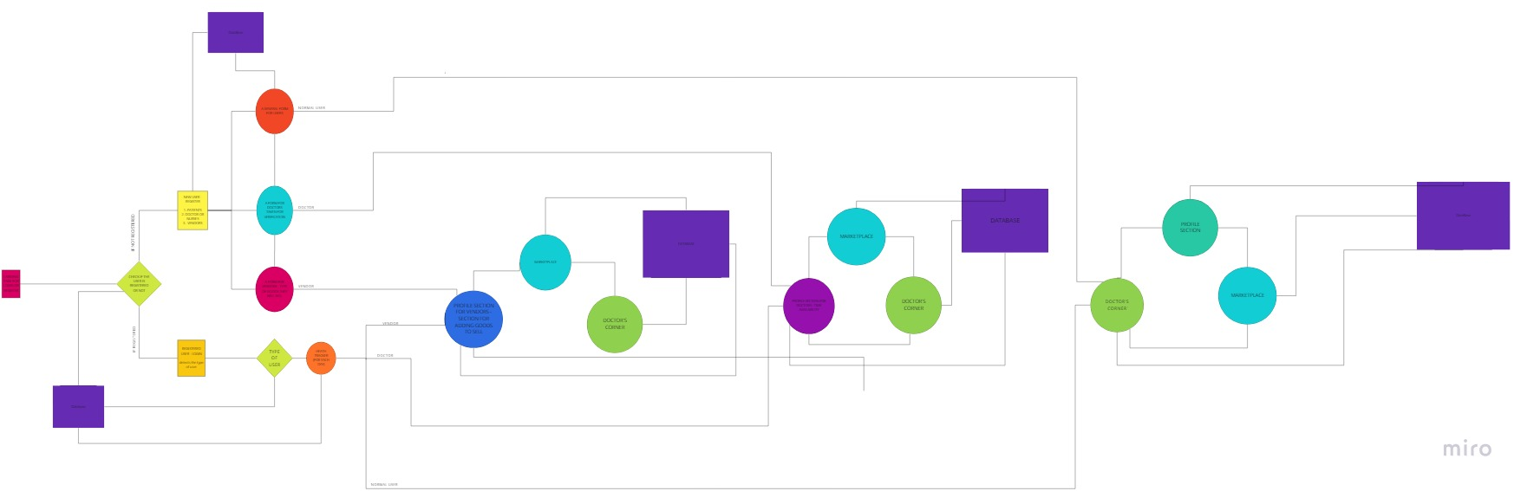
App architecture

Slide 5
Project flowchart
Collecting users data as they sign up!
Storing it in a database i.e. firebase.
Showing relevant data to the users.

Slide 6
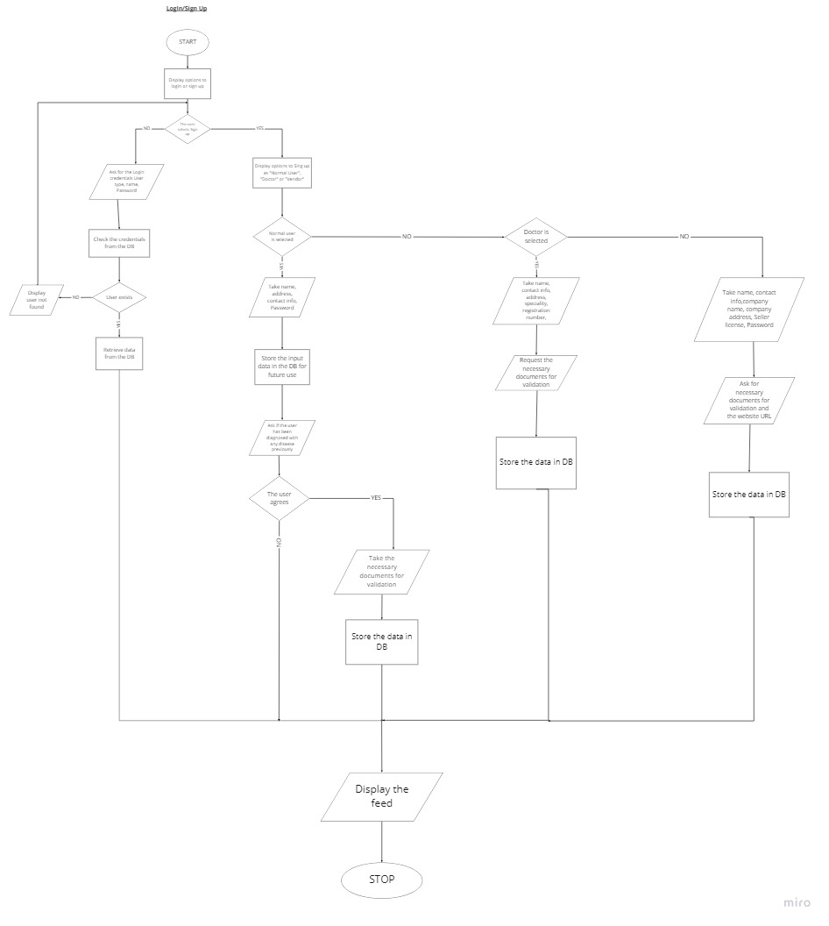
Login/signup algorithm

Slide 7
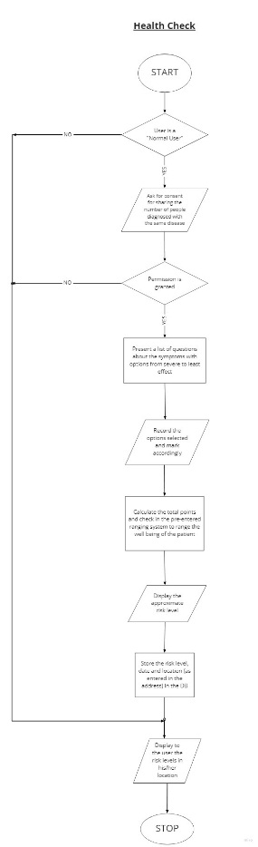
Health check algorithm

Slide 8
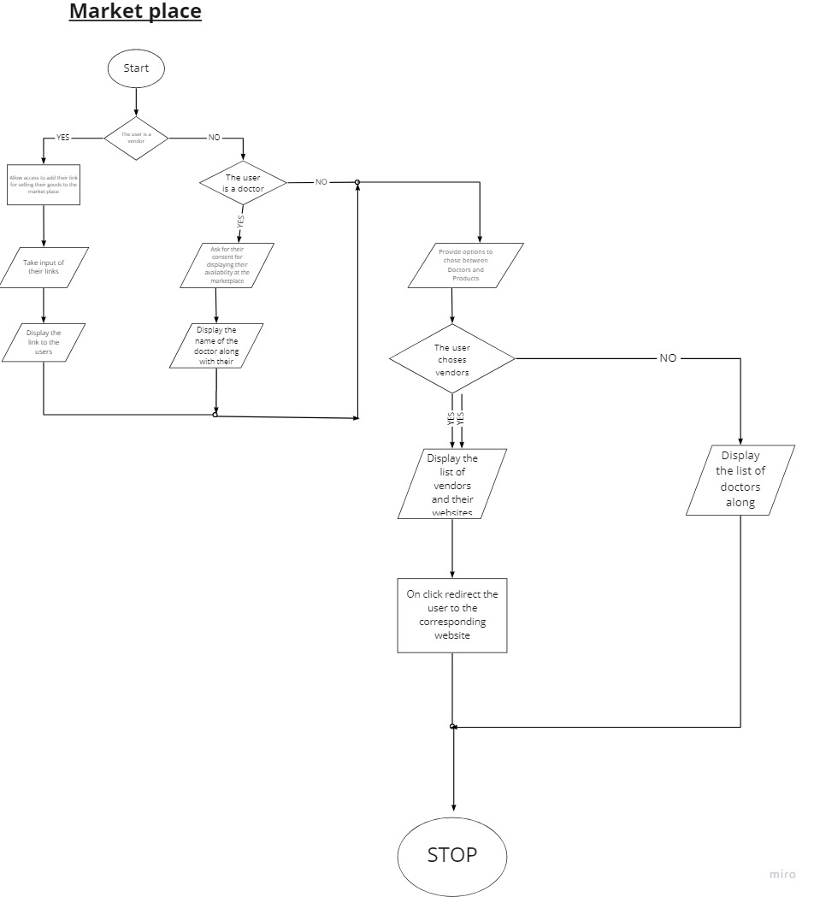
Market place
Algorithm
Demo

Slide 9
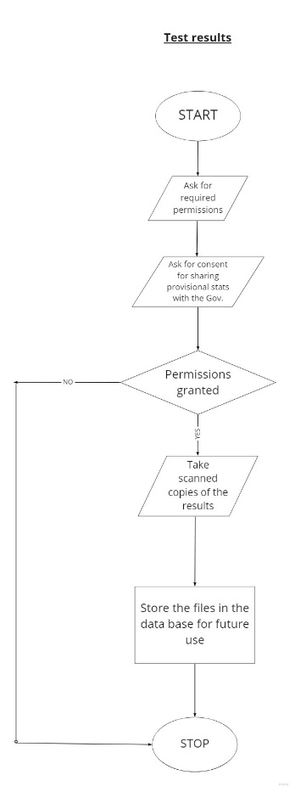
Test results algorithm

Slide 10
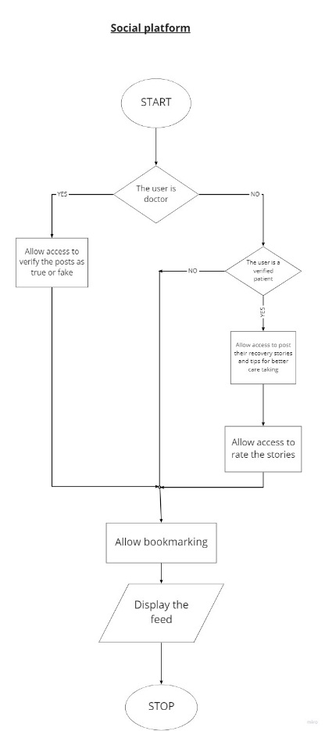
Social platform
Algorithm

Slide 11
Tech Stack used
Programming language - Java
IDE - Android Studio
Database - Firebase by Google

Slide 12
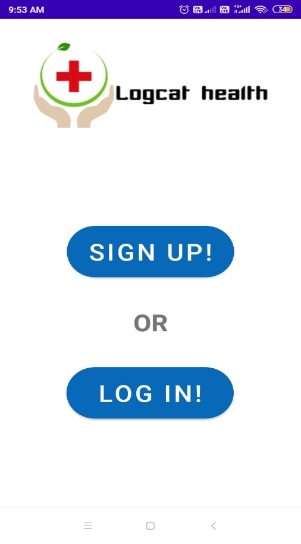
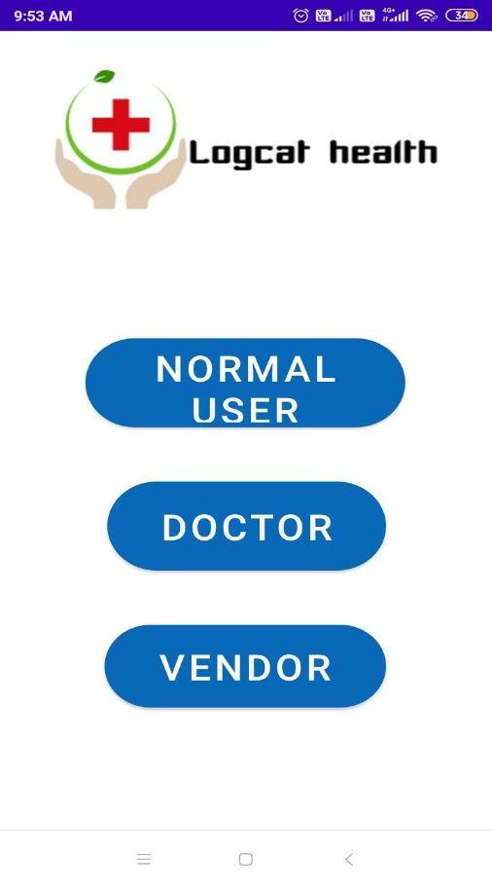
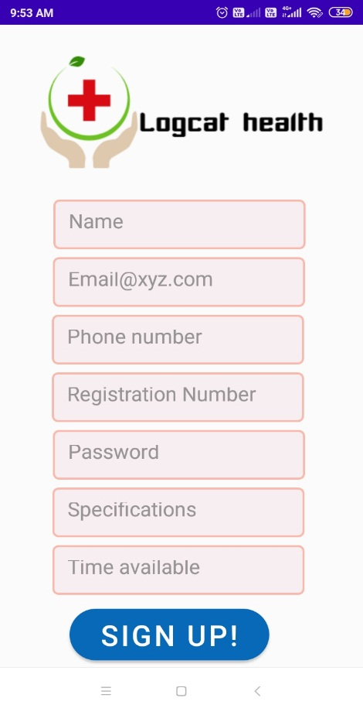
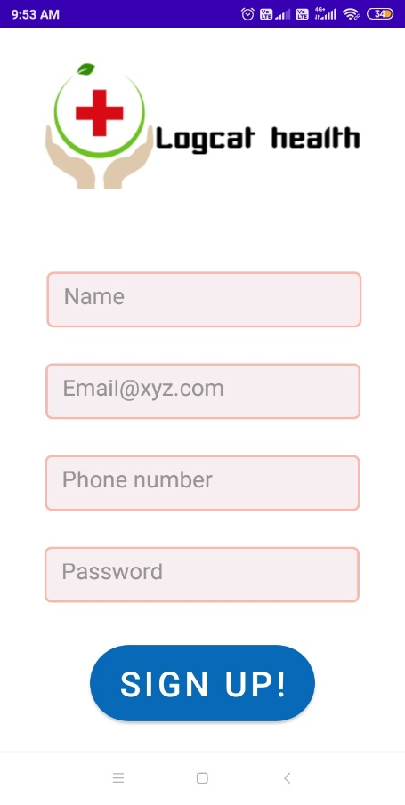
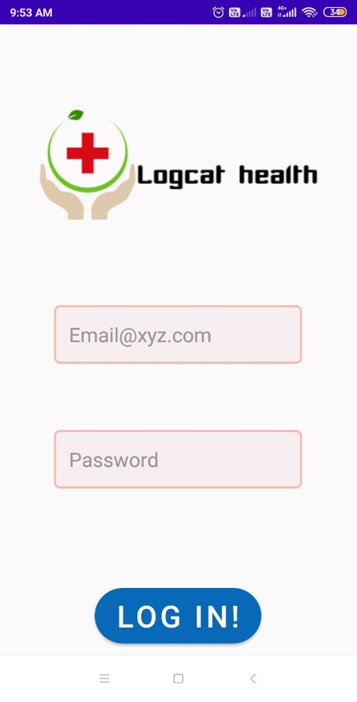
Login/Sign up screenshots
or

Slide 13
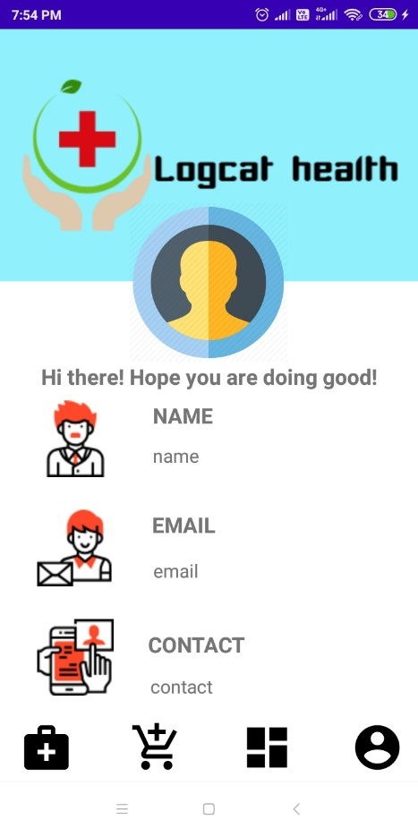
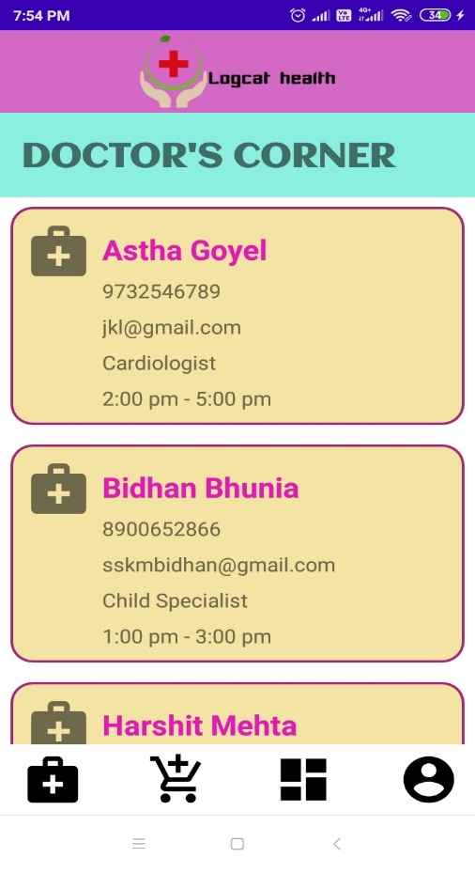
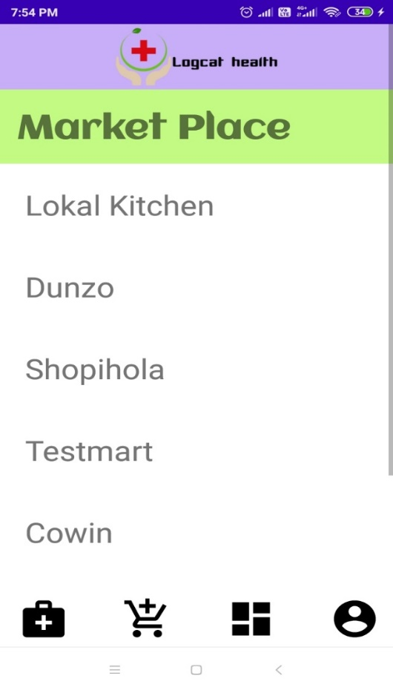
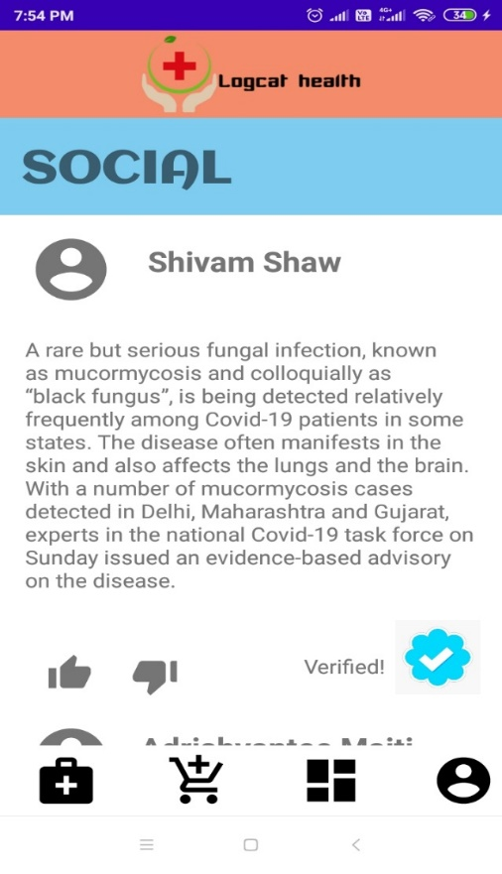
App screenshots
Profile section
Doctor’s corner
Marketplace section
Feed section

Slide 14
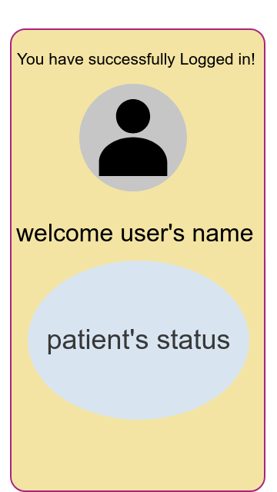
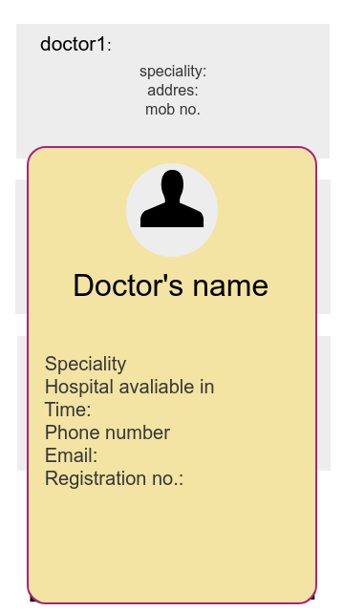
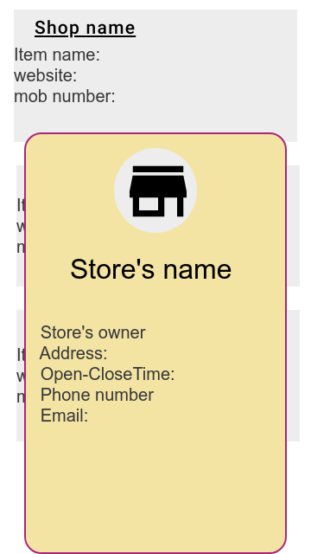
Some more app Mock-ups
Welcome screen
Card showing more doctors info
Card showing more vendor’s info

Slide 15
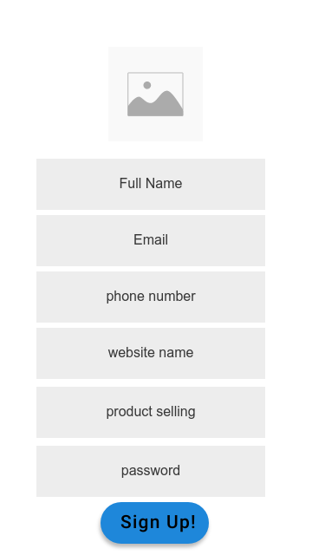
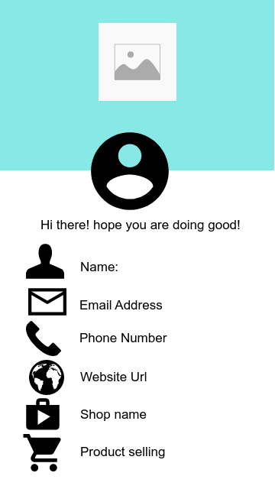
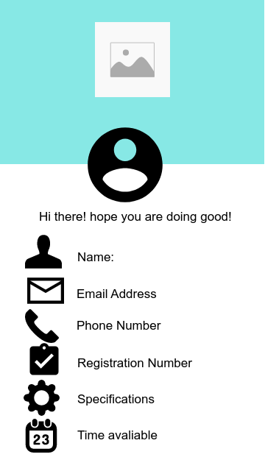
Some more app Mock-ups
Vendor’s sign up page
Vendor’s profile section
Doctor’s profile section

Slide 16
Challenges Faced
Synchronization in work
Time constraints
Future Challenges to come
App is designed to be act on a production level which requires time and effort
The features needs to be updated as per users from time-to time
Future Goals
To work on our mockups and complete our first milestone - adding all the features to this app
To make it an opensource project to collaborate with other developers

Slide 17
THANK YOU!

